Slide 1
Core @ 3 Tesla with Hcal mods
Paul Brindza, ODU
August 17, 2021

Slide 2
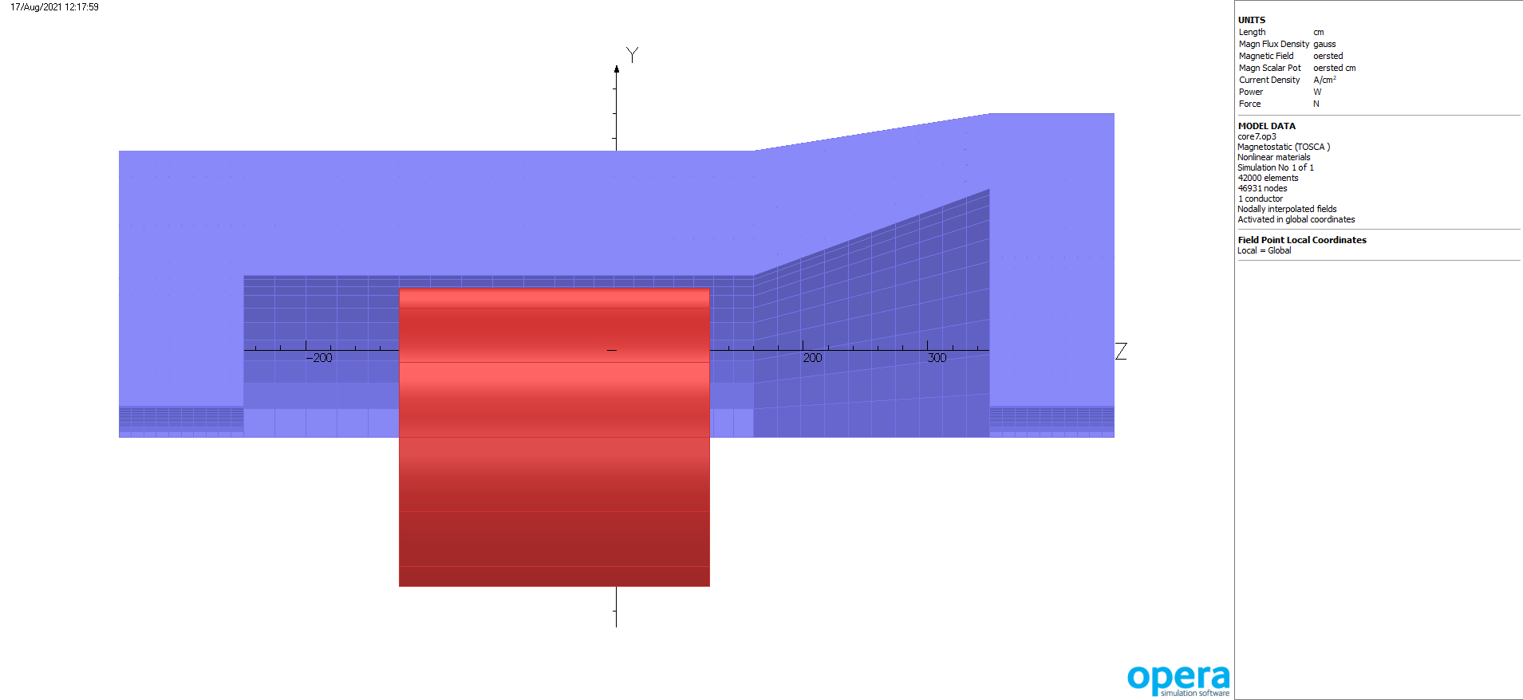
Revised CORE Hcal end @ 3 Tesla

Slide 3
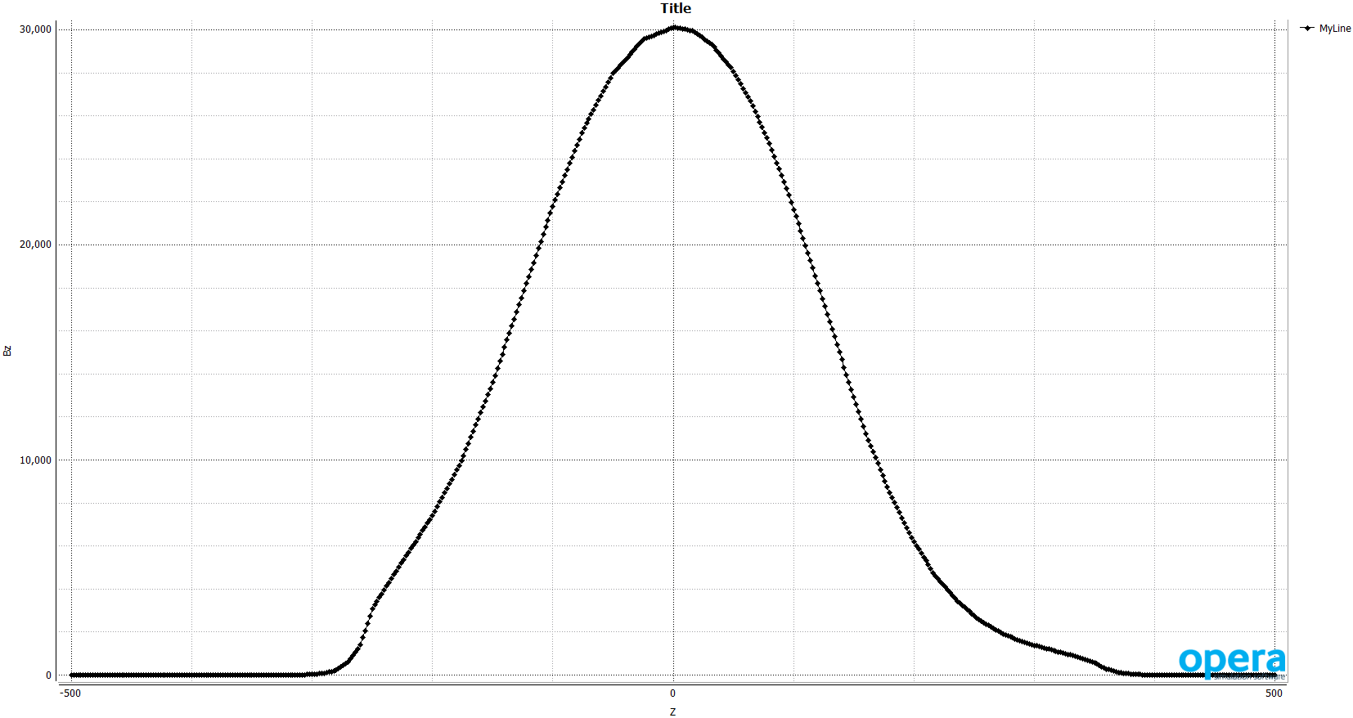
CORE Bz on axis -500 to 500 cm

Slide 4
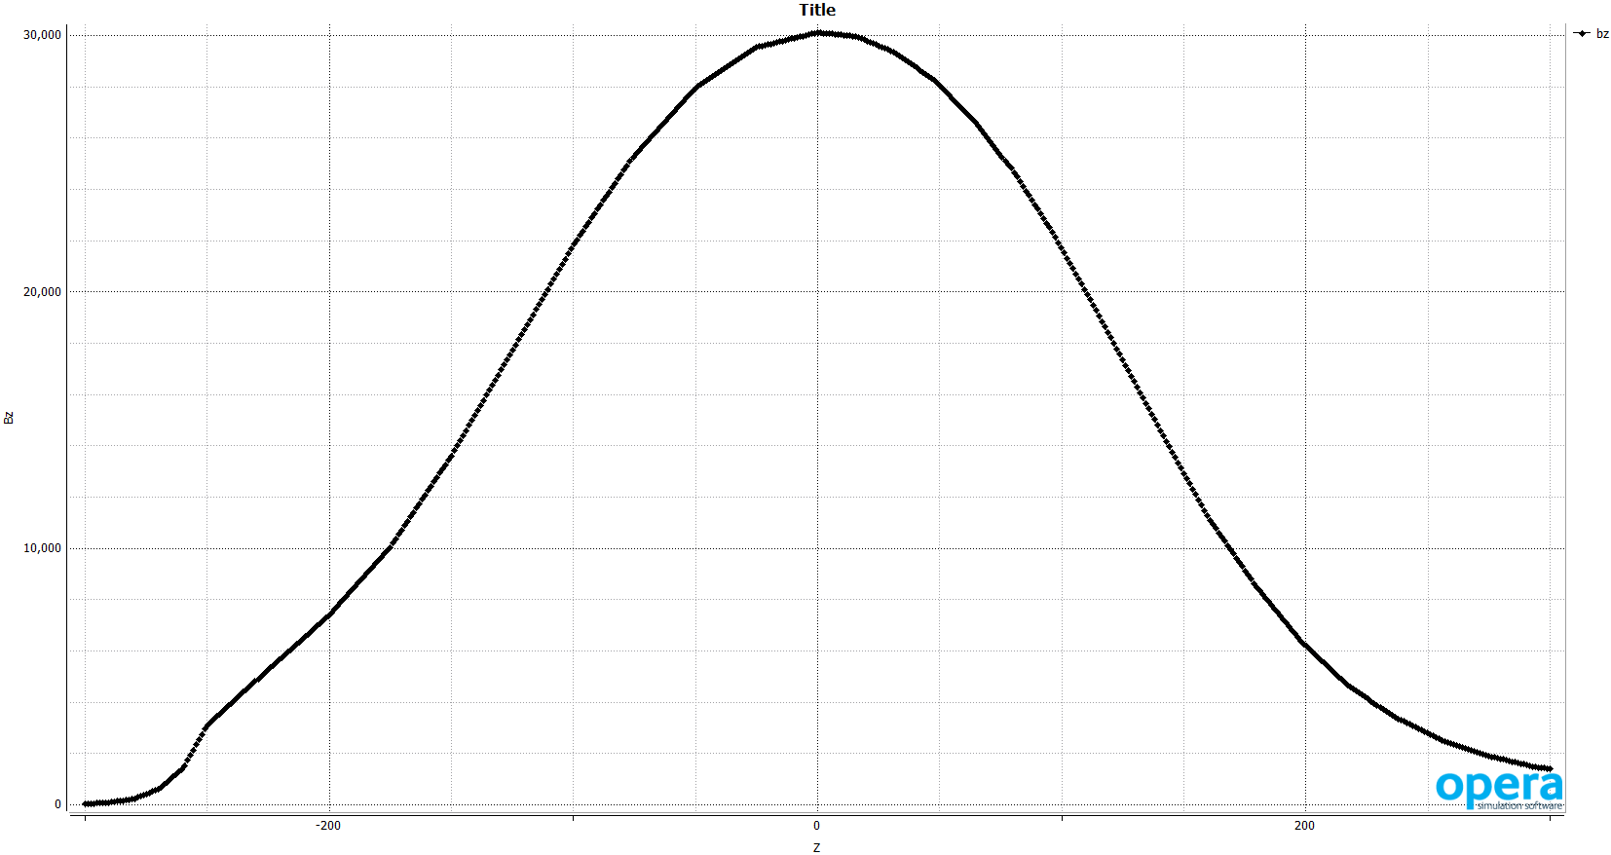
CORE Bz on axis -300 to 300 cm

Slide 5
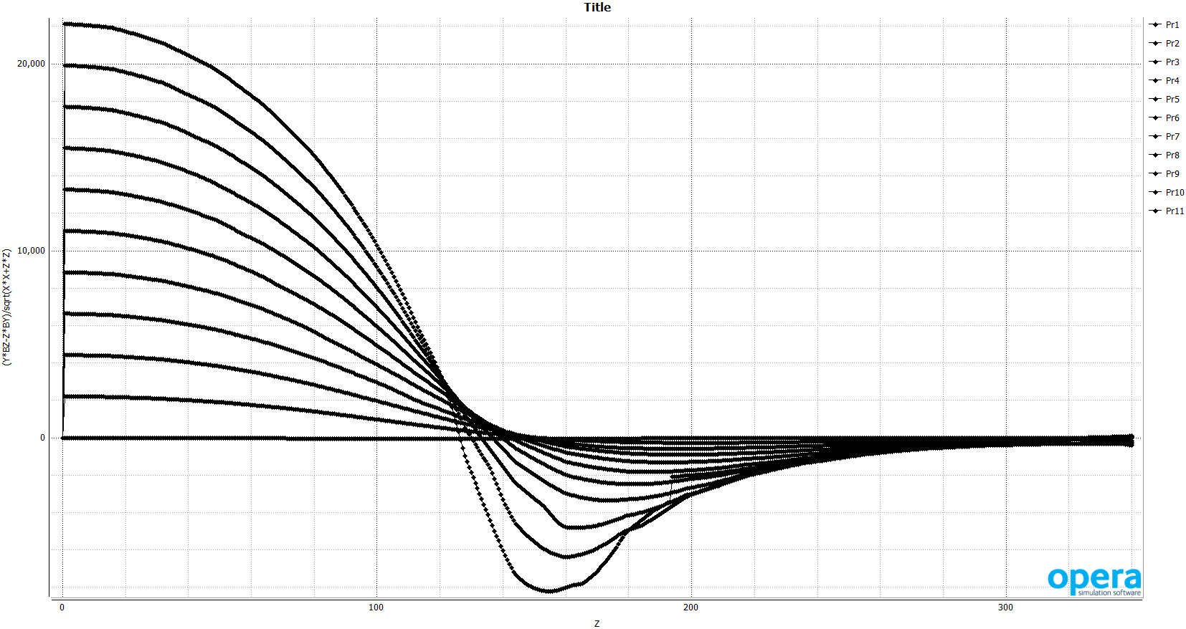
CORE Hcal mod projectivity( 0-250 Y, 0- 300 Z)

Slide 6
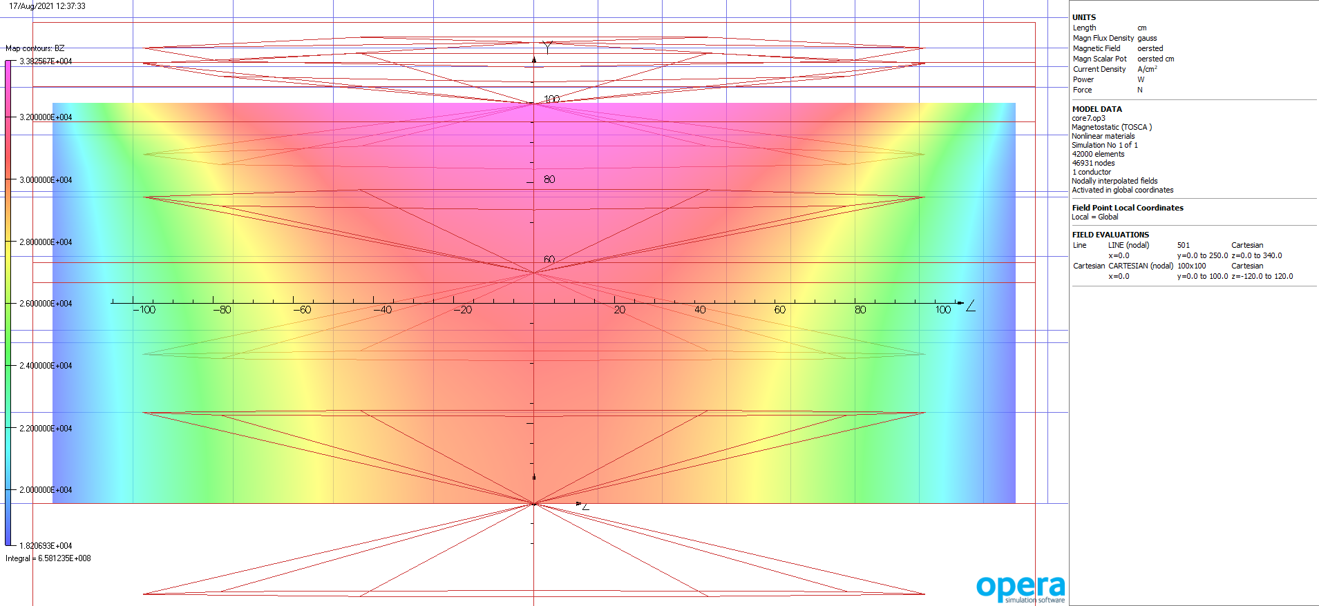
Bz inside solenoid

Slide 7
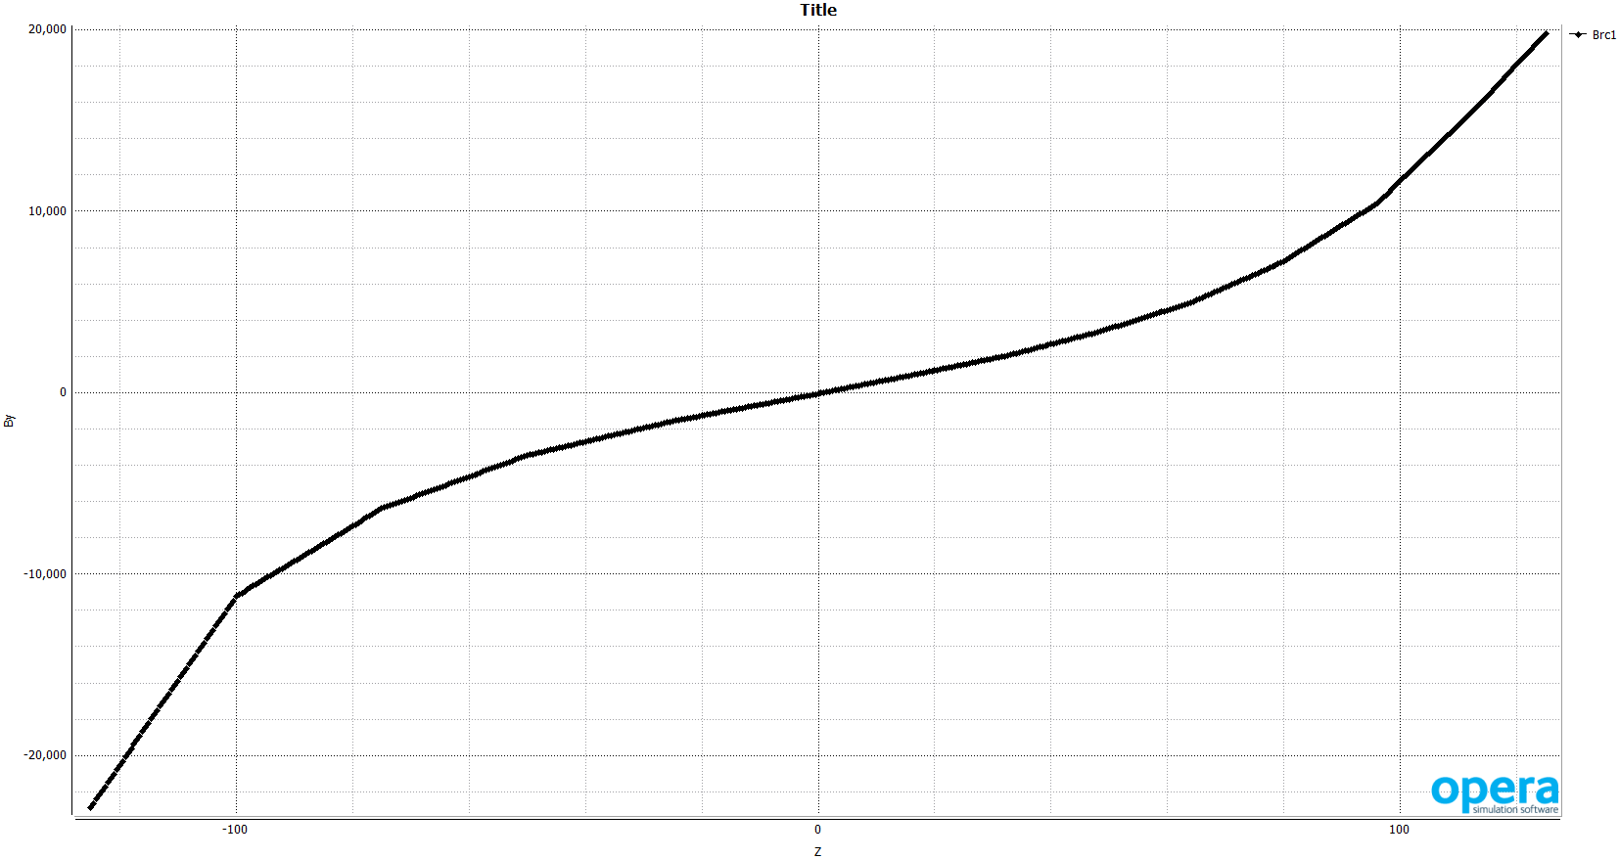
Br coil R =110 cm, -120-120 in Z, nodal fields

Slide 8
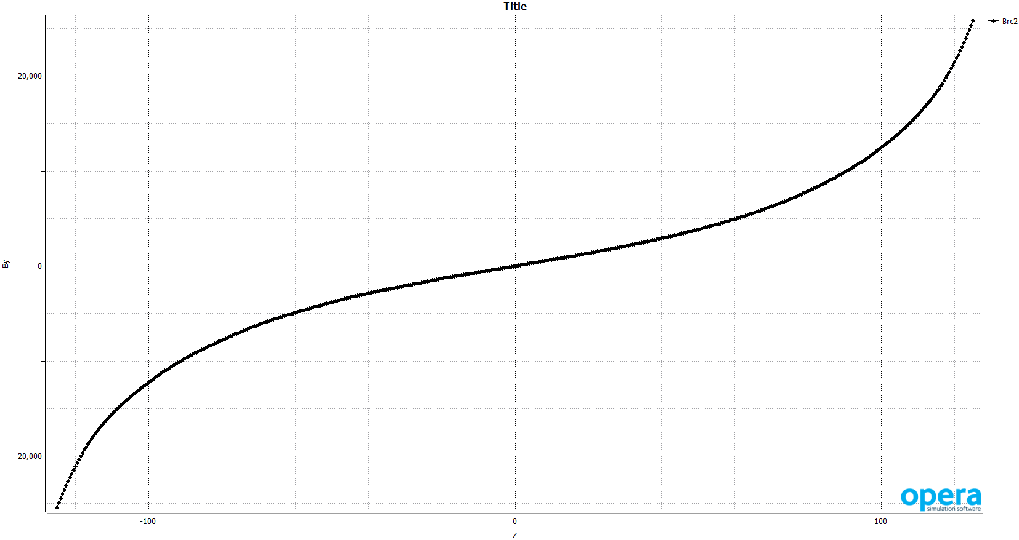
Br coil R =110 cm, -120-120 in Z, integral fields

Slide 9
Coil forces by various methods
Fields | Coil fields | Force newtons | Force pounds
Nodal | Nodal | +1,178,000
Nodal | Integral | -517,735
Integral | Integral | -377,177 | 86,542
By hand( f = - IBrL) |  | -379407
Fz = -Int( J x Br) dV = (Sum Br)/N * I *N* 2Pi R
J is a constant 3200 Amps/cm
R is mid radius 115 cm
I get Br every cm along the coil from Tosca mid coil and then sum

