Slide 1
Production and Detection of Exotic Nuclei in the EIC
Presented by: brynna Moran
Other Collaborators: Ben Collis, Abhay Deshpande, Zach Finger,
Ciprian Gal, Mark Harvey, Barak Schmookler,
Oleg Tarasov, Pawel Nadel-Turonski

Slide 2
Motivating Questions
Would the high-energy electron-heavy nucleus scattering of the future EIC have the capability to produce exotic nuclei?
Can we go on to detect and correctly identify the produced exotic nuclei?
Can we also study the level structure of the nuclei by detecting the decay photons? What requirements does this place on the far-forward detection area?
Notes:
So some of the questions we’re hoping to answer with this research include:
Can we use high-energy electron-heavy nucleus scattering at the future EIC to produce undiscovered and rare isotopes?
Can we go on to detect and correctly identify the produced exotic nuclei? Can we also study the level structure of the nuclei by detecting the decay photons? What requirements does this place on the far-forward detection area?
If we can produce, detect, and identify exotic nuclei at the EIC, how can these results complement the work being done concurrently at dedicated rare isotope facilities such as FRIB?

Slide 3
Rare Isotopes at EIC
EIC isn’t a dedicated rare isotope facility.
Advantages of EIC in Rare Isotope Studies:
- High energy collisions
-Survey-type experiment
Notes:
So the EIC was not designed with rare isotope production in mind, rather it’s focus is [insert]
ASK BARAK: WHAT’S A GOOD WAY TO SUMMURIZE THE MAIN GOAL OF THE EIC IN A REALLY SHORT AND SWEET COUPLE WORDS?
However, it has been theorized that it could also be useful when it comes to the study of exotic nuclei. As a result of the high energy nature of these collisions, many of the de-excitation photons will be Lorentz upshifted to energies much larger than background photons present in the detector area. This will allow for clean detection/identification of these photons,
These studies would be a survey-type experiment, where we could collect data from all these different exotic at once and then analyze, rather than needing to fine-tune for precise measurements.

Slide 4
Rare Isotopes at EIC
EIC isn’t a dedicated rare isotope facility
Advantages of EIC in Rare Isotope Studies:
- High energy collisions
-Survey-type experiment
2 Interaction Regions: IR6 and IR8
2022 EIC Detector Proposal Advisory Panel report cites these types of studies when discussing potential future experiments.
IR 8
IR 6
Notes:
We’re currently looking at two potential interaction regions: IR6 and IR8.
IR6 was designed to meet the physics requirements of the White Paper, while the design for IR8 is still being finalized. When discussing the pre-conceptual layout for IR8, the 2022 EIC Detector Proposal Advisory Panel report specifically mentions the possibility for a program of low-background gamma spectroscopy with rare isotopes in the beam fragments, the specifics of which I’ll return to later in this talk.

Slide 5
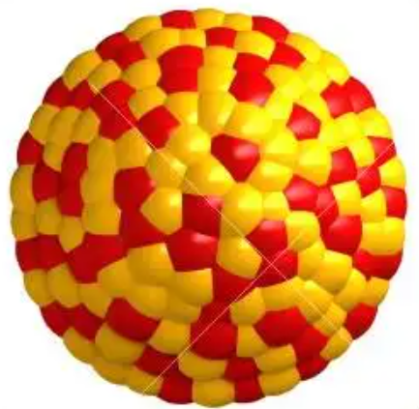
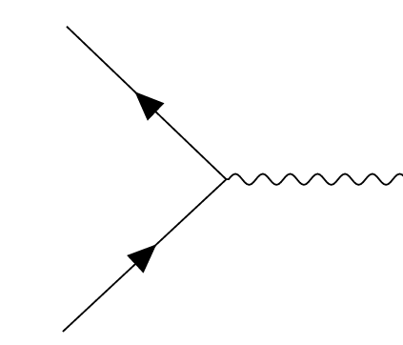
Isotope production at the EIC
Decay of radioactive isotopes
Hard scattering and intra-nuclear cascade
High-energy fission or evaporation
Gamma de-excitation
$$β$$
$$β$$
Incoming 18 GeV electron beam and ~110 GeV/nucleon heavy ion beam
Excited intermediate nucleus (i.e. residual nucleus)
Isotopes in ground state and decay photons
Fission or evaporation products
Isotopes after radioactive decay
t = 0
t = 10⁻²² s
t = 10⁻²⁰ - 10⁻¹⁷ s
t = 10⁻¹⁴ s
t = ? – never (stable)
Notes:
Explain Process

Slide 6
Isotope production at the EIC
$$β$$
$$β$$
Ground State isotopes energy: ~105-110 GeV/nucleon
Gamma value: ~100
Time dilation allows direct detection for short lived decay particles
Isotopes in ground state and decay photons
This is primarily where the EIC could potentially contribute
Notes:
So where the EIC can potentially contribute would be in the Gamma de-excitation region, the ground-state isotopes will be at an energy of around 105 to 110 GeV per nucleon. The time dilation effect will allow for possible direct detection for lifetimes >1ns, and this direct detection can be useful in the study of the isotopes level-structure.

Slide 7
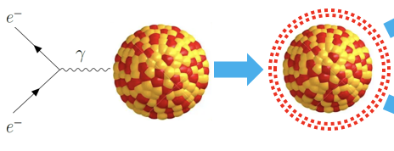
Hard scattering and intra-nuclear cascade using BeAGLE
BeAGLE (Benchmark eA Generator for Leptoproduction) is the software we use to simulate the hard scattering and intra-nuclear cascade
Using BeAGLE, we simulated 10 million events to give us the A, Z, and Excitation Energy (E*) of all the excited intermediate nuclei
Leaves us with the residual nucleus in an excited state for the next stage of simulations
.
Notes:
We use the software BeAGLE to simulate the intra-nuclear cascade and give us the A, Z, and Excitation energy of all isotopes created in 10 million events.

Slide 8
Excited Intermediate Nucleus from BeAGLE
The distribution of isotopes created during this stage
←
Notes:
So here we can see all the different isotopes created in those 10 million events, with the N on the X axis and Z on the Y axis, for the Uranium 238 ion beam.
The red lines show a baseline of all the different types of isotopes that have abraded the same total number of nucleons.

Slide 9
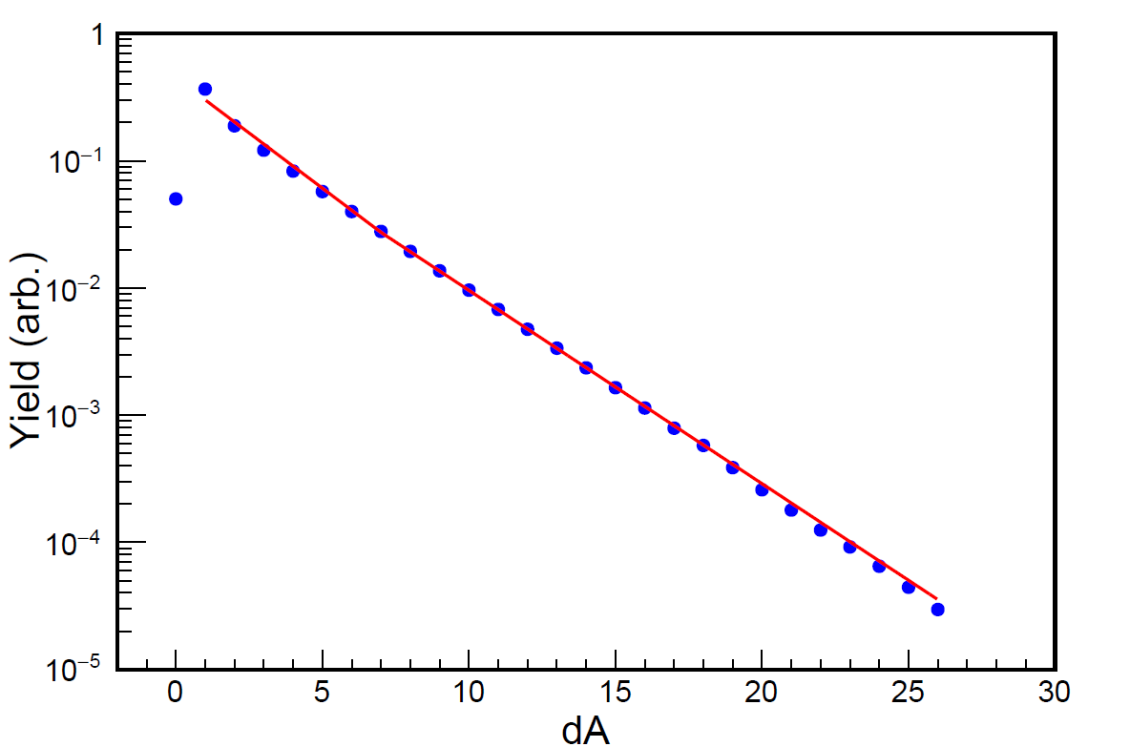
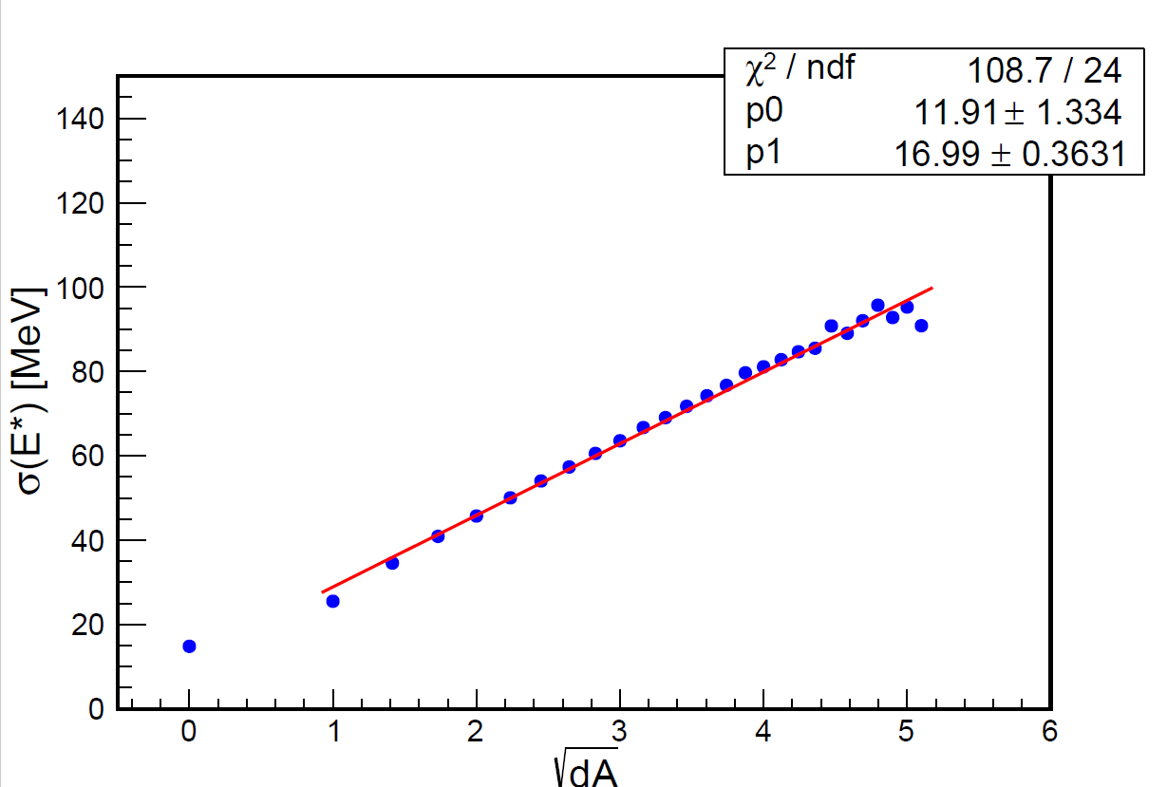
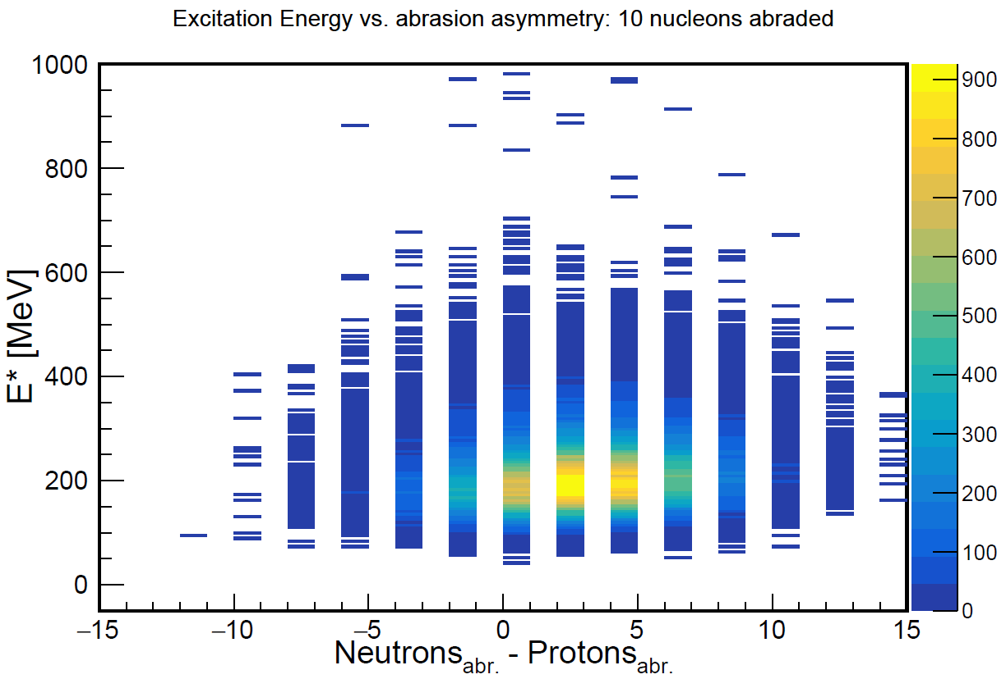
Excited Intermediate Nucleus from BeAGLE
We find that the production of the residual nucleus in BeAGLE manifests as a very simple abrasion model:
The cross section for abrading a given number of nucleons (for dA>1) shows a (piecewise) exponential dependence.
$$dA=A_{beam}−A_{res}$$
For a given number of abraded nucleons, the relative proportion of neutrons and protons abraded is close to a hypergeometric distribution.
The excitation energy shows a simple dependence on the number of abraded nucleons.
Notes:
We can see a there’s a very simple dependence when we look at the excitation energy of the residual nucleus as a function of how many nucleons were abraded.
If we look at the relative production cross section as a function of dA, we can see an exponential dependence.
And then if we look at the relative proportion of the number of neutrons and protons abraded, we can see a hypergeometric-like distribution.

Slide 10
High-energy fission/evaporation and Gamma Decay using FLUKA and ABLA07
To simulate the high energy decay and gamma de-excitation, we had 2 good options: FLUKA and ABLA07
FLUKA:
Directly incorporated into the BeAGLE framework, allowing for easier analysis
Used extensively in high-energy physics, but not rare isotope production
ABLA07:
The second part of the abrasion-ablation code ABRABLA07
Used extensively in rare isotope community
We ran the BeAGLE events through both programs and compared the results.
Notes:
For each event, the residual nucleus with a given A, Z, and excitation energy is then handed over to either FLUKA or ABLA07 for decay (fission or evaporation) followed by gamma de-excitation. We’re then left with the decay products of the residual nucleus.
The FLUKA decay of the residual nucleus has been directly incorporated into the BeAGLE simulation framework, which allows for easier analysis. However, FLUKA is used primarily in high-energy physics, it hasn’t been used for the study of rare isotope production, whereas ABLA07 is used extensively in the rare isotope community, and is the second part of the abrasion-ablation code ABRABLA07.
We run the BeAGLE events though both these codes and compare the results.

Slide 11
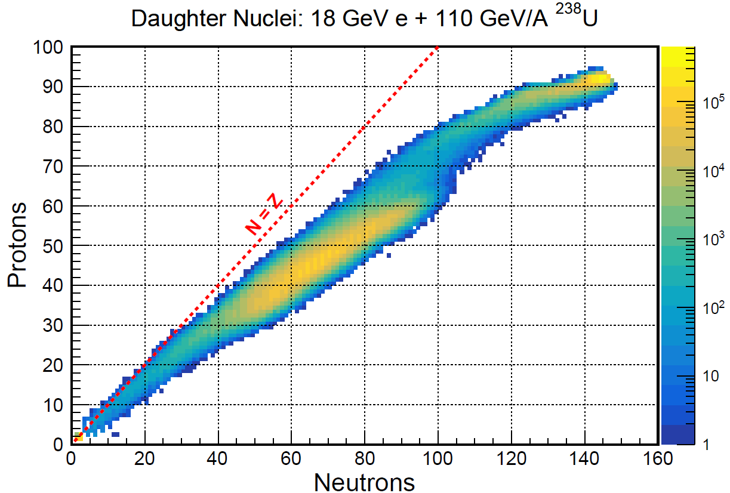
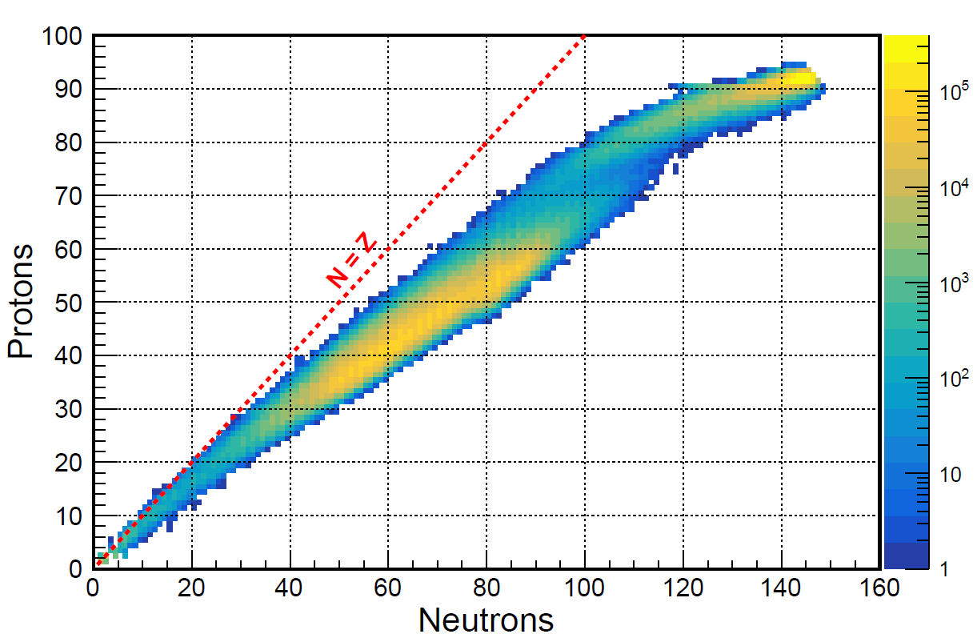
Fission and Evaporation Products in High Energy Decay
FLUKA
ABLA07
10 million events simulated
11
Notes:
So if we look at the isotopes created in this high energy decay, we can see that FLUKA and ABLA07 give us very similar distributions.

Slide 12
Fission and Evaporation Products in High Energy Decay
Evaporation
Fission
FLUKA
ABLA07
Fission
Evaporation
10 million events simulated
12
Notes:
You can see that the majority of these isotopes fall into one of these two regions, the excited intermediate nucleus either decays into one larger product, which would fall into the evaporation region, or into two smaller products which would be the fission region.

Slide 13
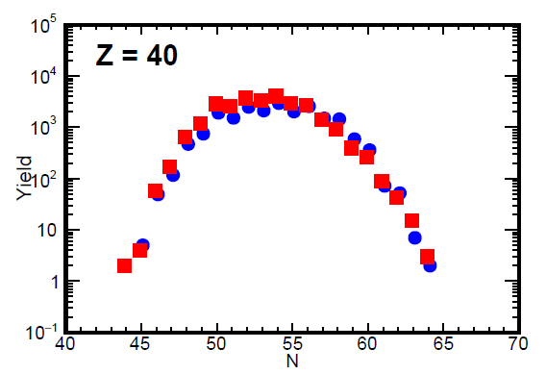
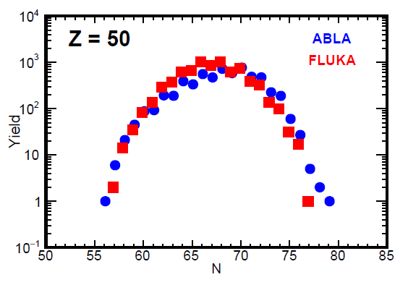
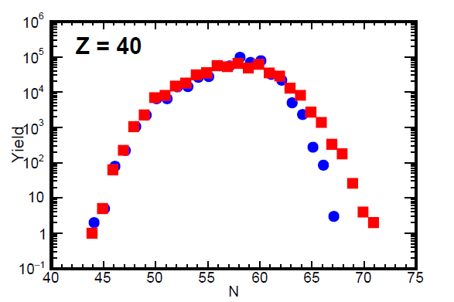
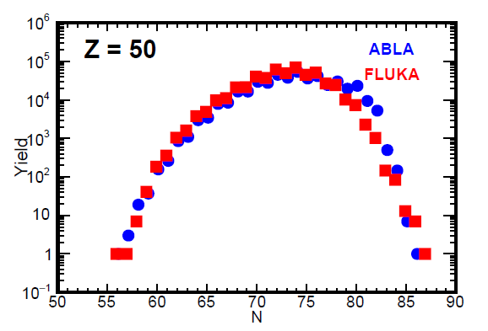
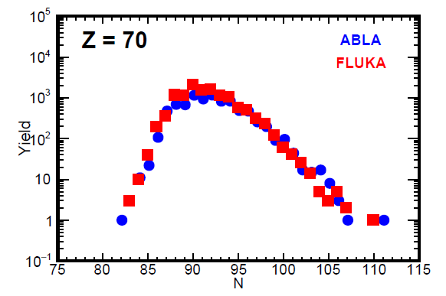
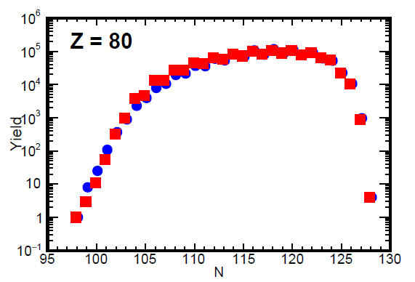
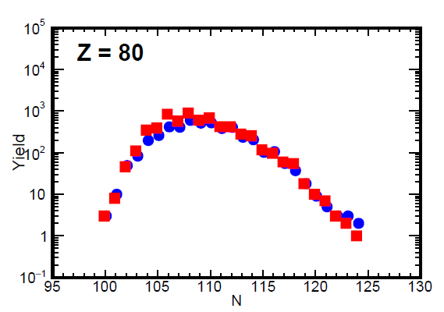
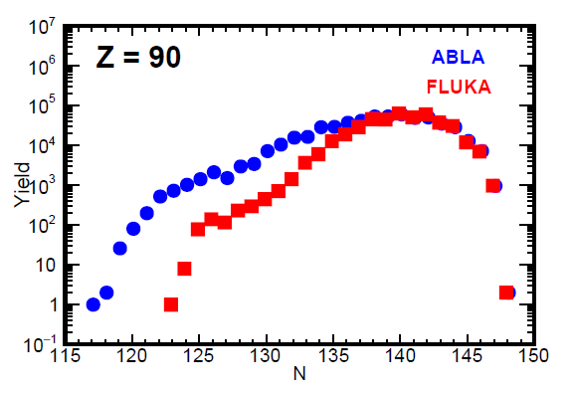
We can directly compare the results of FLUKA and ABLA07
²⁰⁸Pb
²³⁸U
Notes:
If we look at the yield of all isotopes produced of various elements, we can see that FLUKA and ABLA07 give incredibly similar results, with some discrepancies at the tails. Overall these two programs are in agreement and shows that FLUKA can be relied upon for simulations of rare isotopes.

Slide 14
Running High Statistics for High Scattering and Intra-Nuclear Cascade
If we make the assumptions that
1) we collect 10 fb⁻¹ integrated luminosity per year and
2) the production of nuclear isotopes is independent of the kinematics (i.e. Q² and x),
Those 10 million events correspond to ~5 min actual runtime, which isn’t enough to get a full understanding of the EIC’s capacity to produce rare isotopes.
To get ~1-2 months, that requires simulating ~100 billion events. Very computationally expensive!
Notes:
So the previous analysis was for 10 million events, however we’re going to need to simulate much more than that.
When we used a pythia6 simulation to generate over the entire allowed kinematic phase space (i.e. all the way down to photoproduction), we saw that the total scattering cross section is about 100 μb. ASK WHAT ARE THESE UNITS apparently, they’re barns!
If we assume that we collect 10 fb⁻¹ integrated luminosity per year and that the production of isotopes is independent of the kinematics, this means that we can roughly assume that 10 million events corresponds to about 5 minutes run time.
Generating over a billion events with BeAGLE can become computationally expensive. To
The decay isotopes only care about the intermediate nucleus A, Z,and excitation energy (Eexc). We can create a basic parameterization of the BeAGLE intermediate isotope production and then use that when simulating the fission/evaporation and subsequent gamma de-excitation

Slide 15
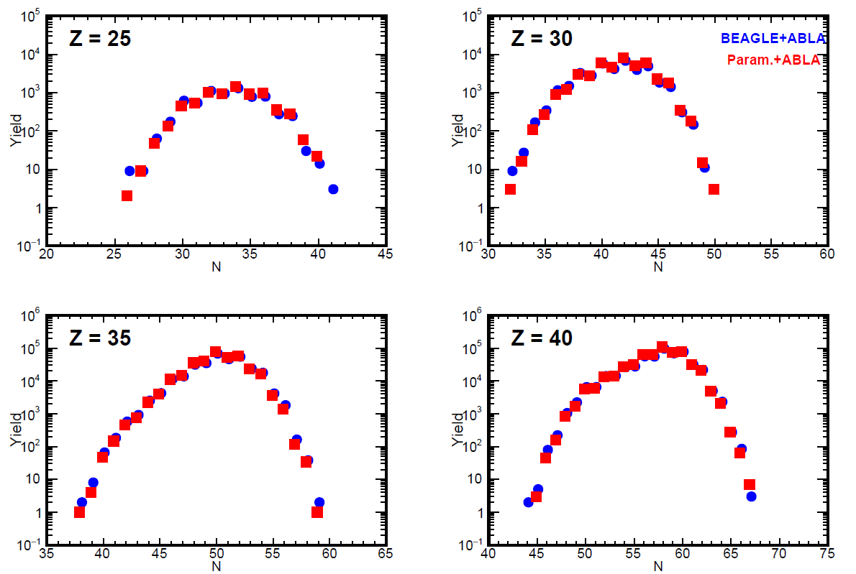
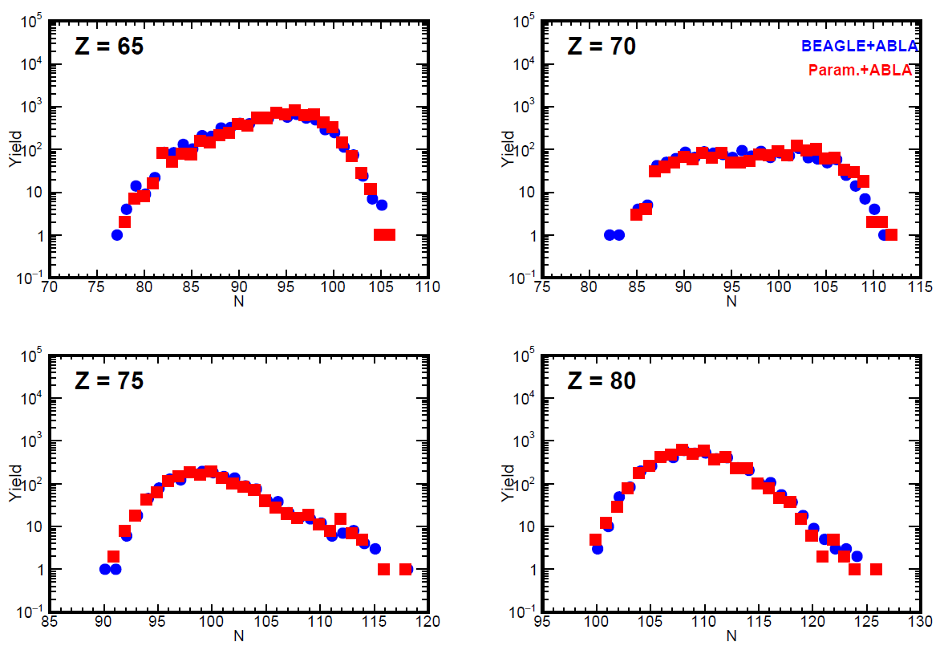
Comparison of BeAGLE results and parameterized distribution
Decay isotopes only care about A, Z, and E* of excited residual nucleus. We can create a basic parameterization of the BeAGLE intermediate isotope production and use that.
Using our parameterized model for the excited residual nucleus, we can generate 10 million events in 15 minutes.
Notes:
Fortunately, decay isotopes only care about A, Z, and E* of excited residual nucleus. We can create a basic parameterization of the BeAGLE intermediate isotope production and use that.
To compare our parameterized distribution for high statistics to the full BeAGLE simulation, we can compare the isotopes created in the high energy decay as simulated by ABLA, using the input from the BeAGLE results and the parameterized method. Here we can see that the results are very consistent, suggesting that this is a viable tool to run events in the numbers we need.
ASK: IS THIS FOR U238 OR PB208?

Slide 16
Towards higher statistics simulations
Param.+ABLA
10 million events
Param.+ABLA
100 million events
Notes:
Using this same parametrization, we can look at how the decay products distribution changes as we increase the number of simulated events from 10 million to 100 million. We can see on the left graph that the distribution using the parametrization is almost identical to that of the distribution using BeAGLE, and on the left we can see that when we expand to 100 million events the same basic shape stays the same, but we see a much higher yield.
Is it notable that it’s fuller on the fringes of the evaporation region?

Slide 17
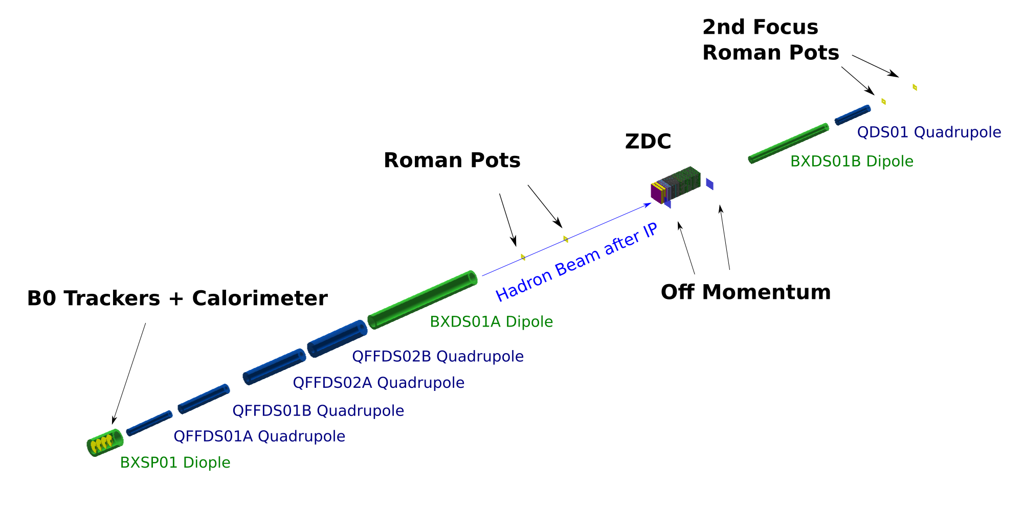
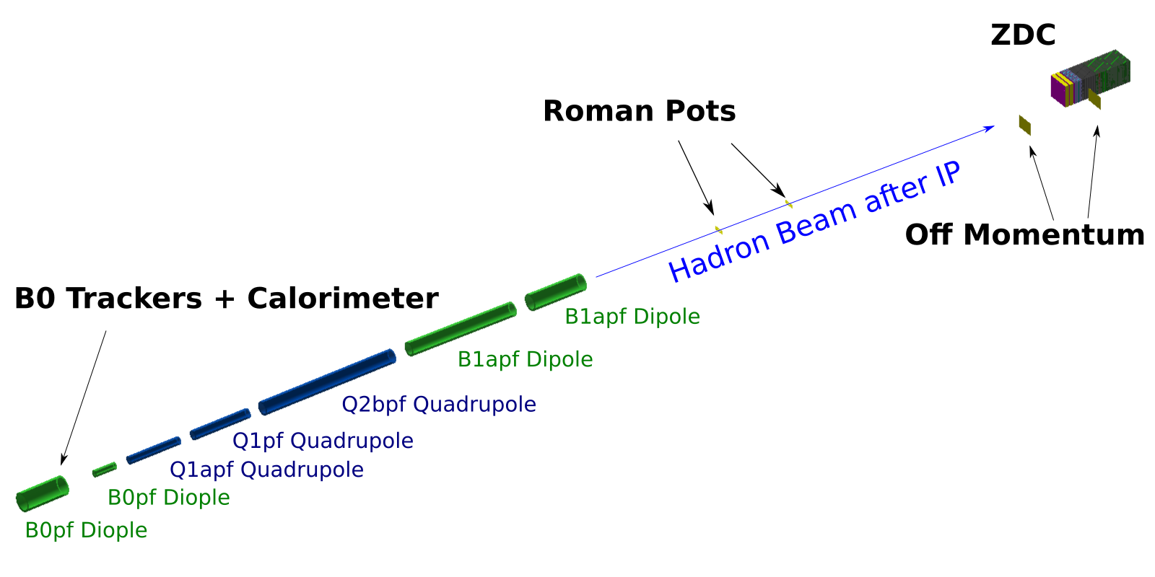
Detection and identification of the nuclear isotopes
IR6
IR8
Far forward magnets and detectors in the Fun4All simulation framework
Notes:
To analyze the detection of these decay particles, we used the software Fun4All to simulate the trackers, detectors, and magnets in far forward region. As I mentioned before, we’re interested in both IR6 and IR8. The main difference between these two regions is that IR8 has a second set of roman pot detectors, and this second focus could have some significant advantages when it comes to detection.

Slide 18
We can then calculate the isotope hit position at a RP and the acceptance/exclusion area
Hit position:
$$x_{RP}= D_{x}\left(−R_{Rel}\right)=D_{x}\left(1−x_{L}\right)$$
Minimum allowed hit position:
$$x_{min}=10σ_{x}=10\sqrt{β_{x}ε_{x}+D_{x}^{2}σ_{p}^{2}}$$
Accelerator Parameters:
$ε_{x}=43.2 nm$ (EIC CDR Table 3.5)
$σ_{p}=6.2×{10}^{−4}$(EIC CDR Table 3.5)
IR6 Parameters at first RP:
$$β_{x}=865 m$$
$$D_{x}=−16.7 cm$$
$$→ x_{min}^{RP1}=6.11 cm$$
IR8 Parameters at first RP:
$$β_{x}=2.28 m$$
$$D_{x}=38.2 cm$$
$$→ x_{min}^{RP1}=0.39 cm$$
Big acceptance difference between the two IRs is caused by the second focus at the RPs in the IR8 design
Notes:
We can calculate the exclusion area at the roman pots of the two interaction regions. This depends primarily on this beta function of the various interaction regions at the first roman pot. The second focus of IR8 means that it’s beta function is small, which means that it has a much smaller exclusion area.

Slide 19
Roman Pot Acceptance
IR6
IR8
Isotope hit positions at the first RP vs. isotope Z
Includes all isotopes known/potential (NNDC and LISE++ database)
RP Positon Resolution of 10—100 microns
Notes:
Here we can look at the acceptance of Roman Pots of all individual known and potential isotopes that come from a combined NNDC and LISE++ database. We assume here a RP position resolution of 10-100 microns. We can see that Isotopes with the same Z are well separated according to their mass, which shows that a large fraction of the potential isotopes can be accepted and correctly identified using the position at the RP.
We can see here that IR8 obviously has a much higher acceptance rate, however the rest of the detection analysis shown here is done in IR6 because the layout for IR8 isn’t entirely finalized.
.

Slide 20
ZDC Acceptance

Slide 21
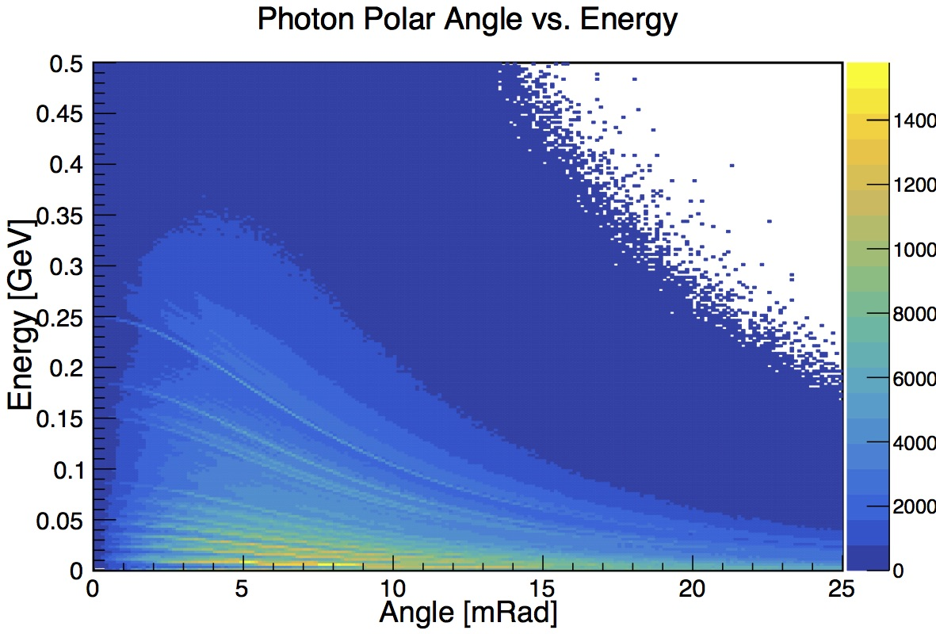
ZDC Acceptance
→

Slide 22
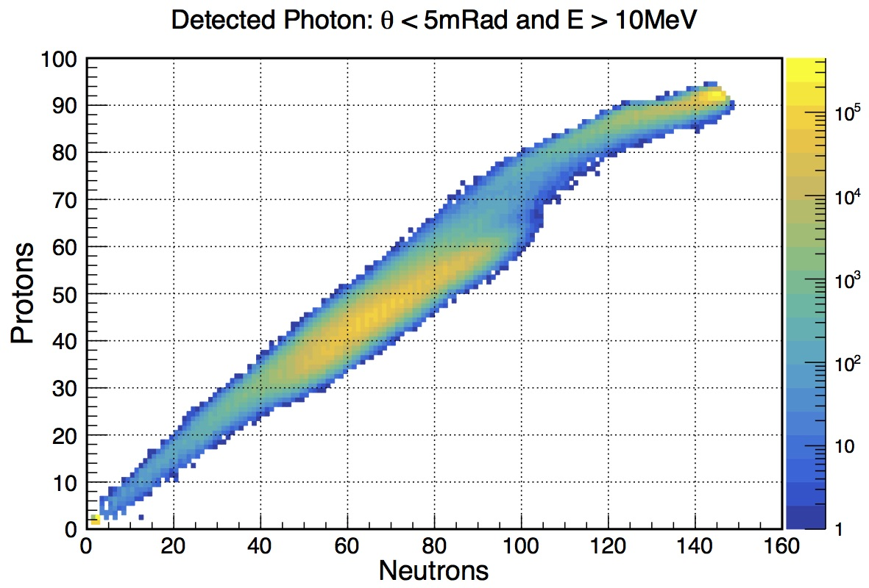
ZDC Acceptance
If we zoom in, we can see that most isotopes are within the acceptance region

Slide 23
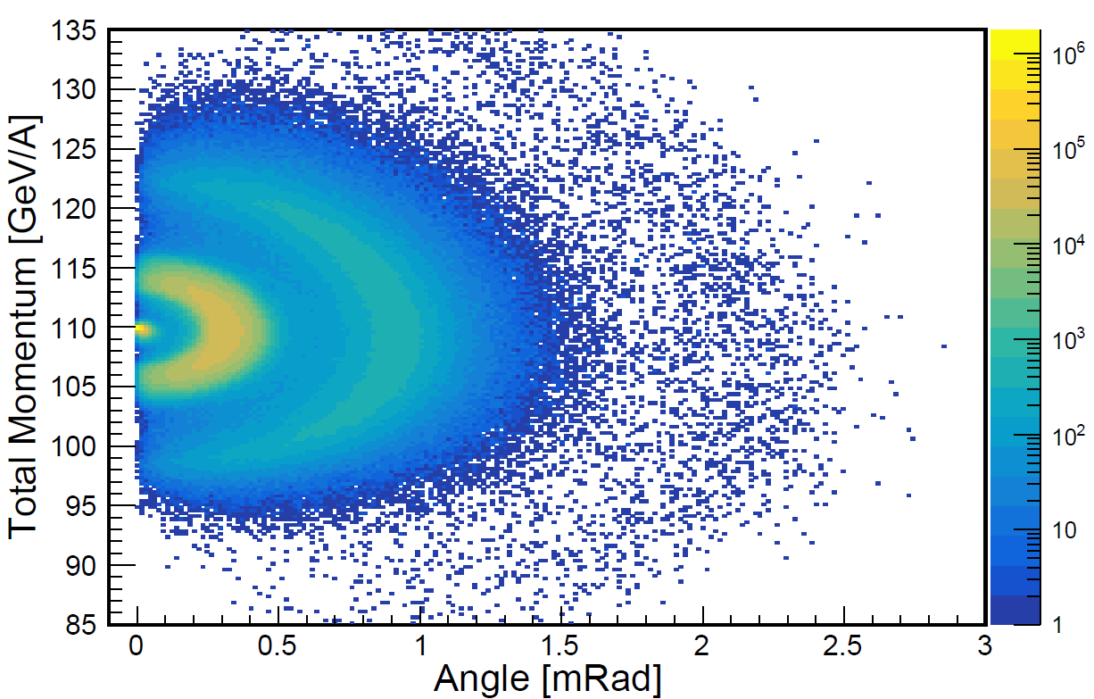
Identification of Isotopes in IR6
To determine initial kinematics:
$$\left[\begin{matrix}θ_{x,ip} \\ θ_{x,ip} \\ R_{rel}\end{matrix}\right]=\left[\begin{matrix}0.387 & −0.428 & 0 \\ 0 & 0 & 1.95 \\ −0.359 & 5.89 & 0\end{matrix}\right]\left[\begin{matrix}x_{rp2} \\ θ_{x,rp} \\ y_{rp2}\end{matrix}\right]$$
To identify isotopes, we use the relationship
$xL =$ $\frac{R}{R_{Beam}}=\left[{\left(\frac{A\text{p}\text{N}}{Z}\right)}/{\left(\frac{A_{beam}\text{p}\text{N}\text{,}\text{beam}}{z_{beam}}\right)}\right]$
Using the assumption P_{N} = P_{N,Beam} :
=> $\frac{A}{Z}$ = ($Rrel+1)\left[\frac{A_{Beam}}{Z_{Beam}}\right]$
Notes:
This plot here suggests that at low angles, daughter isotopes of the residual nucleus will have per-nucleon momenta very close to the incoming ion beam momentum and a very small scattering angles with respect to the ion beam. With this assumption,
We can reconstruct the initial kinematics of the isotope using this reconstruction matrix, and we can use that reconstructed rigidity and this relationship shown here to reconstruct the A/Z ratio of the indivual isotope.
If we assume assume that the charge of the isotope (Z) can be determined using a ZDC detector behind the roman pot, then this would allow us to calculate the A and identify the isotope.
A thin (few mm thick) quartz bar can be placed in the RPs at the second focus behind the tracker to determine Z². The quartz bar would be perpendicular to the beam, extended along the dispersive (x) direction. The number of Cherenkov photons produced will be quite large, and the challenge will be to measure the photons with high enough precision.

Slide 24
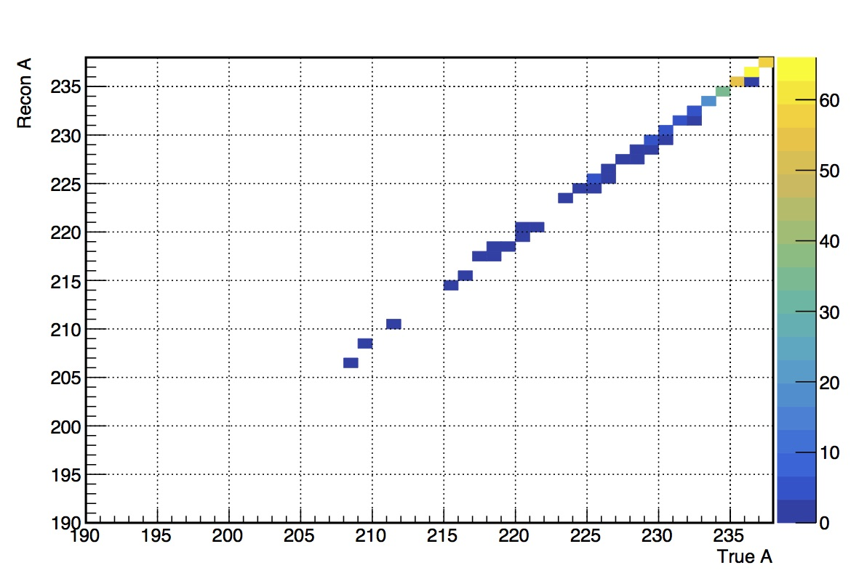
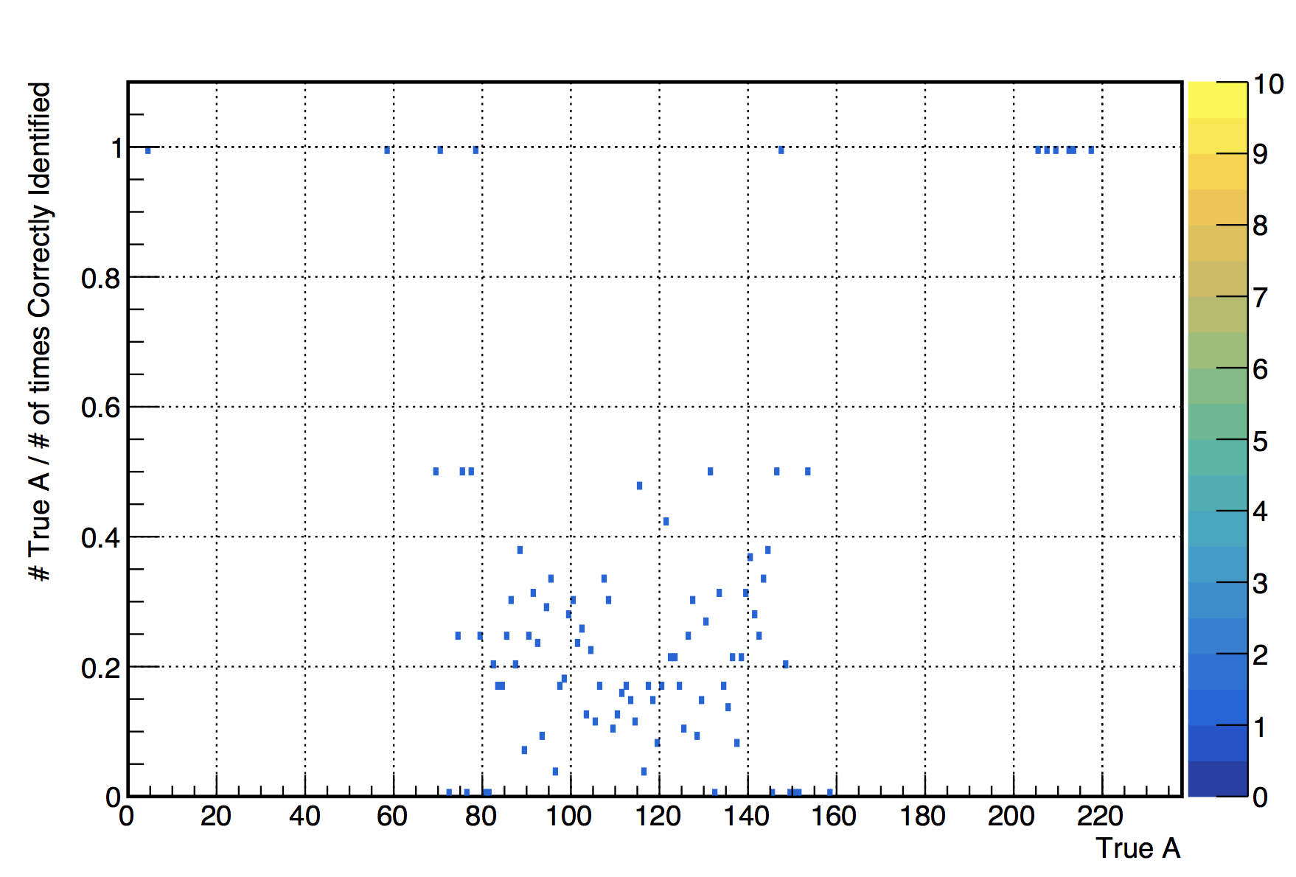
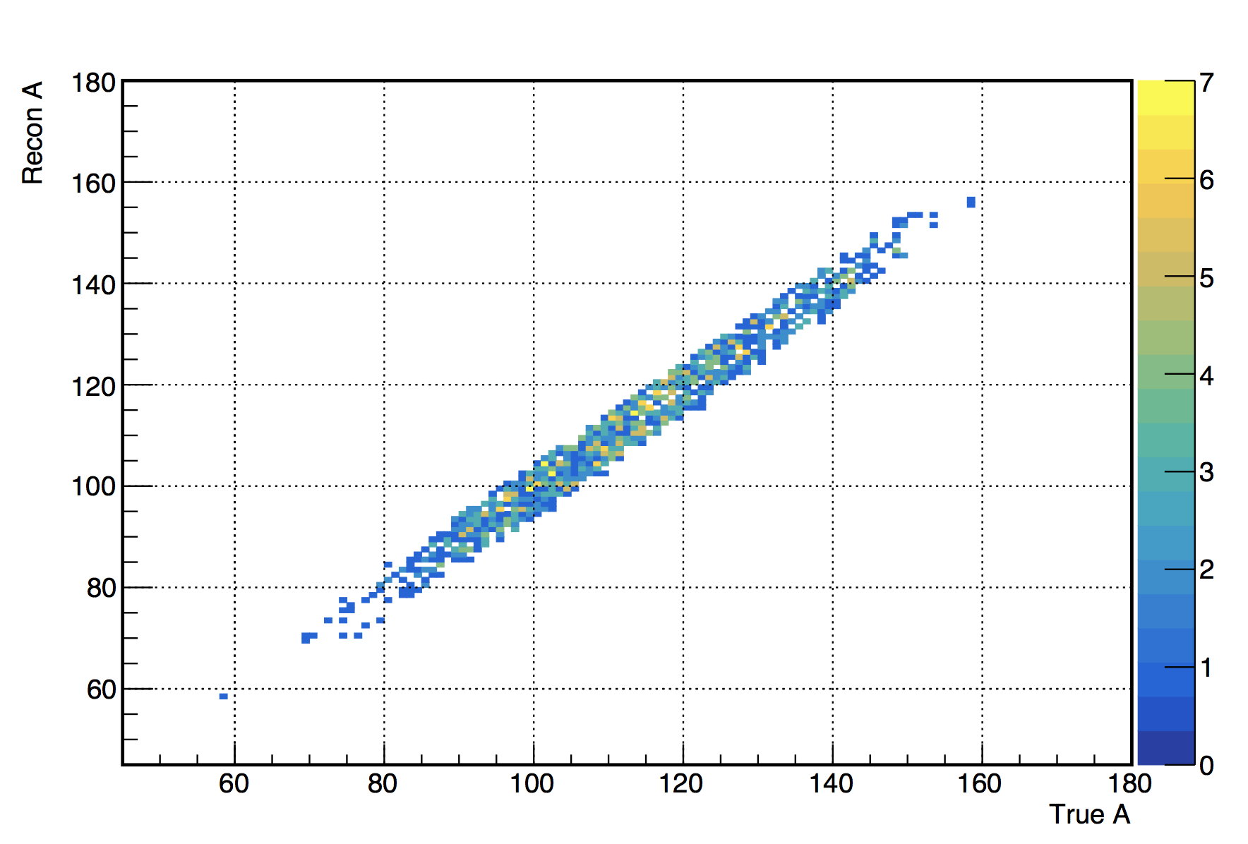
A Reconstruction in IR6

Slide 25
A Reconstruction in IR6
Fission
Evaporation

Slide 26
A Reconstruction
Fission
Evaporation
Our initial assumption about the momentum doesn’t hold for isotopes with larger scattering angles (mostly fission products)
Notes:
The reason for this [the poor results in the fission region] is the result of our initial assumption of P_n = P_beam only holds for events in the evaporation region which have a smaller scattering angle. We’ve started working on using this relationship between scattering angle and momentum to more accurately reconstruct these isotopes.
From Oleg: “May be to mention the next? Two fission fragments are correlated in kinematics. With our knowledge of the production mechanism using machine learning it is possible to improve mass resolution.”

Slide 27
In Summary
We have shown that the EIC has the potential to produce exotic nuclei.
These nuclei can be detected and identified using the proposed optics of the second interaction point with its secondary focus.
Studying the level structure of the produced isotopes will be possible through the detection of the de-excitation photons.

Slide 28
Thank you for listening!

Slide 29
Backup Slides

Slide 30
Using this 10 million ²³⁸U event sample, we see hints of exotic nuclei production
ABLA07 predicts the creation of the undiscovered isotope ²⁰⁷Th
FLUKA – Fission Region
ABLA07 – Evaporation Region
FLUKA predicts the creation of the undiscovered isotope ¹³³Ag

Slide 31
Detection and Reconstruction
$$Rigidity = R =\frac{p}{Z}$$
$xL =$ $\frac{R}{R_{Beam}}=\left[{\left(\frac{A\text{p}\text{N}}{Z}\right)}/{\left(\frac{A_{beam}\text{p}\text{N}\text{,}\text{beam}}{z_{beam}}\right)}\right]$
$$Relative Rigidity = R_{Rel} =\frac{R−R_{Beam}}{R_{Beam}}= xL − 1$$
Using the assumption P_{N} = P_{N,Beam} :
$xL = Rrel+1 =\left( {\frac{A}{Z}}/{\frac{A_{Beam}}{Z_{Beam}}}\right)$ => $\frac{A}{Z}$ = ($Rrel+1)\left[\frac{A_{Beam}}{Z_{Beam}}\right]$

Slide 32
To do:

Slide 33
LISE++ Plots

Slide 34
ZDC Acceptance of de-excitation photons
Need to replace this with the more zoomed in & cut above 10 MeV
Unsure if this should go here, talk more about level structure?

