Slide 1
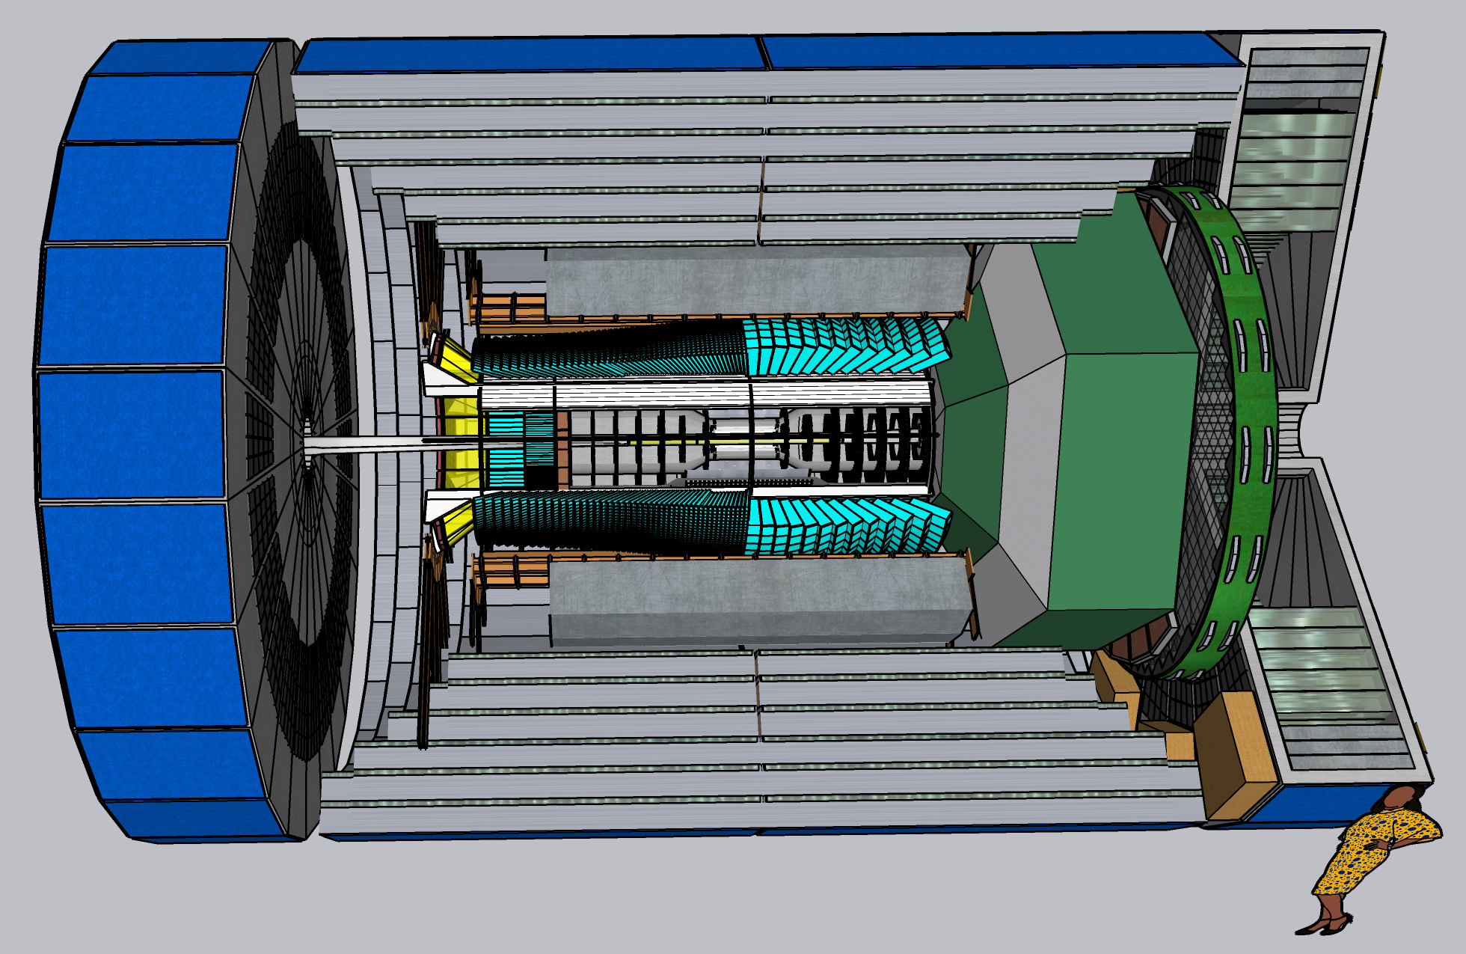
CORE General Meeting
24 March 2022
24 March 2022

Slide 2
Agenda
DPAP Report
CORE Participation in Project Detector
Publication of CORE Proposal
Organizing a CORE Study Group for a second EIC detector
CORE and the second EIC detector

Slide 3
DPAP Report
Based on the projections presented by ATHENA and by ECCE proposals, the panel expects that either detector will be able to fully realize the baseline physics case and to make significant contributions in areas beyond. The panel estimates the same to be true for the CORE detector, with the proviso that the corresponding performance studies are in part less detailed compared with the other two proposals.
The CORE studies for DVCS and exclusive meson production find that the reaction kinematics can be reconstructed from the central detector alone…. The panel regards this as a good example of specialization/optimization to enhance the complementarity between two detectors...
The CORE proposal makes a convincing case for the significant gain in physics reach achievable with a secondary focus:

Slide 4
DPAP & next steps of Detector 1
“The three proto-collaborations are led by experienced, strong leadership teams…. Nevertheless, none of the three proto-collaborations is yet large enough or strong enough for successful development of a detector for Day 1 of the EIC.”

Slide 5
CORE and the Project Detector
We have met two or three times with project management since the DPAP Close-Out
The Project Detector is open to everyone’s participation
A new Collaboration will form
ECCE is the new Reference Design
The EIC Project and EIC community now has one year to develop a detailed Baseline Design for CD2/CD3A (to be finalized by ~May 2023)

Slide 6
Publication of CORE proposal
New overleaf of stripped down proposal (no costing or collaboration details)
https://www.overleaf.com/read/mbkfftsjrtkc
Need to update the SIDIS fig.8 (replace with true p_{h⊥} distributions)
Plan for joint NIM publication of all three proposals + supplemental materials
Possible additional CORE physics studies (e.g. DPAP questions).

Slide 7
CORE Study Group for a 2nd Detector
Two-Three Contacts
Elected for 1 year term
Working Group Convenors
Physics
Detector
Interaction Region
Software
Liaison to Project Detector
Integrate CORE members into Project Detector (as desired)
Coordinate and inform Detector 1 and 2 efforts
Subject to revision and/or dissolution as EIC community forms one Study Group for a 2nd Detector, (including CORE).
Straw Person Proposal
Notes:
contacts: 2+, elected with a one year term
working groups: physics, detector, and IR
each with an elected convener/contact and subgroups as needed
software convener
liaison to Detector 1 (to coordinate efforts)
other functions on an ad-hoc, voluntary basis

Slide 8
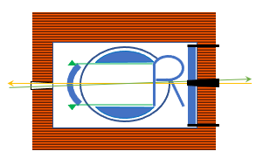
Key aspects of a compact detector
Lower cost (without compromising any physics capabilities)
The performance of many subsystems (DIRC, EMcal, etc) does not depend on the overall system size or location. A compact detector simply has fewer modules, making it more cost-effective.
Lower risk
A smaller new solenoid is not only less expensive but has lower technical and schedule risks.
A shorter detector is easier to integrate into the IR, as it leaves more space for accelerator infrastructure near the collision point and reduces challenges related to solenoid compensation.
Synergies with IR8 (and the physics opportunities enabled by a secondary focus)
The lower cost equivalent subsystems makes it affordable to invest in key capabilities.
An example is a PbWO₄ EMcal for eta < 0, which makes it possible to reconstruct DVCS kinematics using the photon, while only tagging the proton or ion (fragments) in the Roman pots. in combination with the low-p_{T} acceptance with a 2nd focus, creating new opportunities for imaging of ions beyond He.
Complementarity
A compact 3 T solenoid can in combination with an all-Si tracker provide excellent tracking resolution, and is technologically complementary to the hybrid tracker in a 1.5 T BaBar solenoid in Detector 1.

