Slide 1
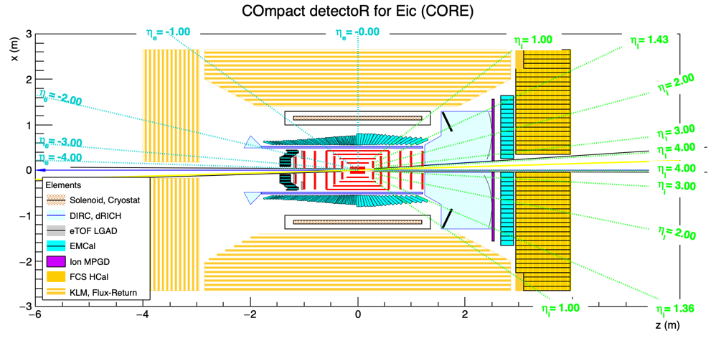
CORE General Meeting
27 January 2022

Slide 2
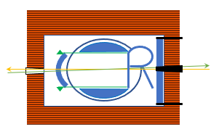
Agenda
Review of Meetings with DPAP
Discussion for Publication of Proposal and Supplemental Materials
Expectation of acceleration of CORE activity after March 1
Outreach
Speaker diversification
Documentation
Extended simulations
U.S. NSAC Long Range Plan

