Slide 1
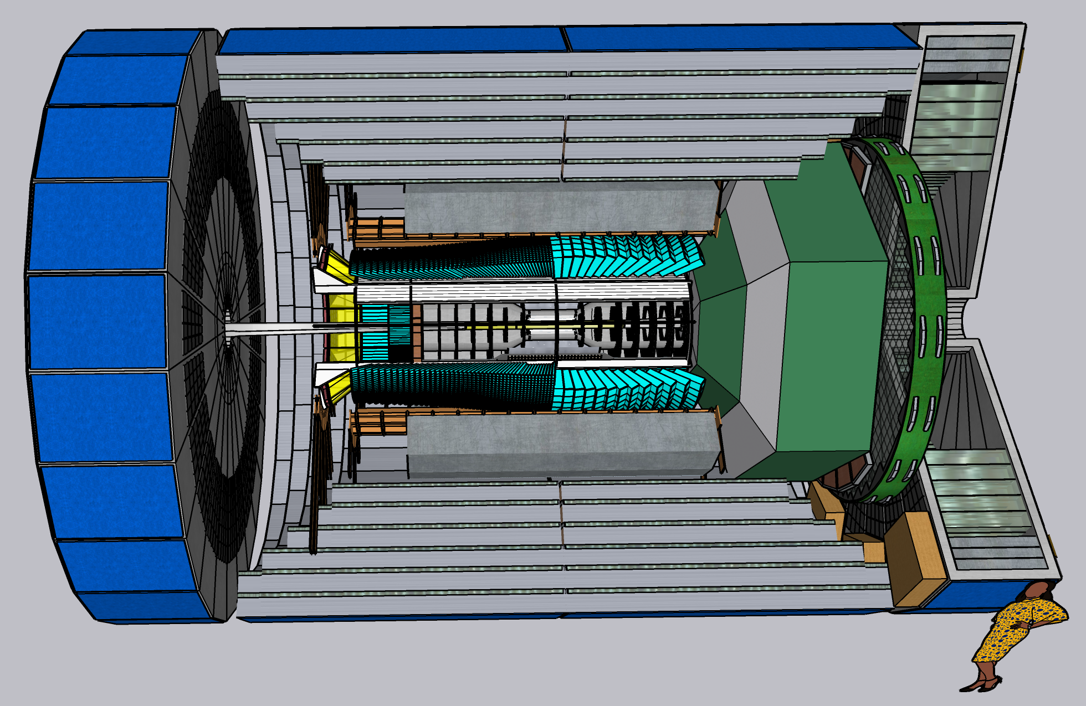
CORE General Meeting
24 March 2022
4 April 2022

Slide 2
Agenda
DOE program for Generic Detector R&D for the EIC
Beyond the “Project Detector”
To be started in US FY2022 (Before Oct 1, 2022)
CORE Software Update
Wenliang (Bill) Lee
Discussion of CORE as “reference” for second EIC detector

