Slide 1
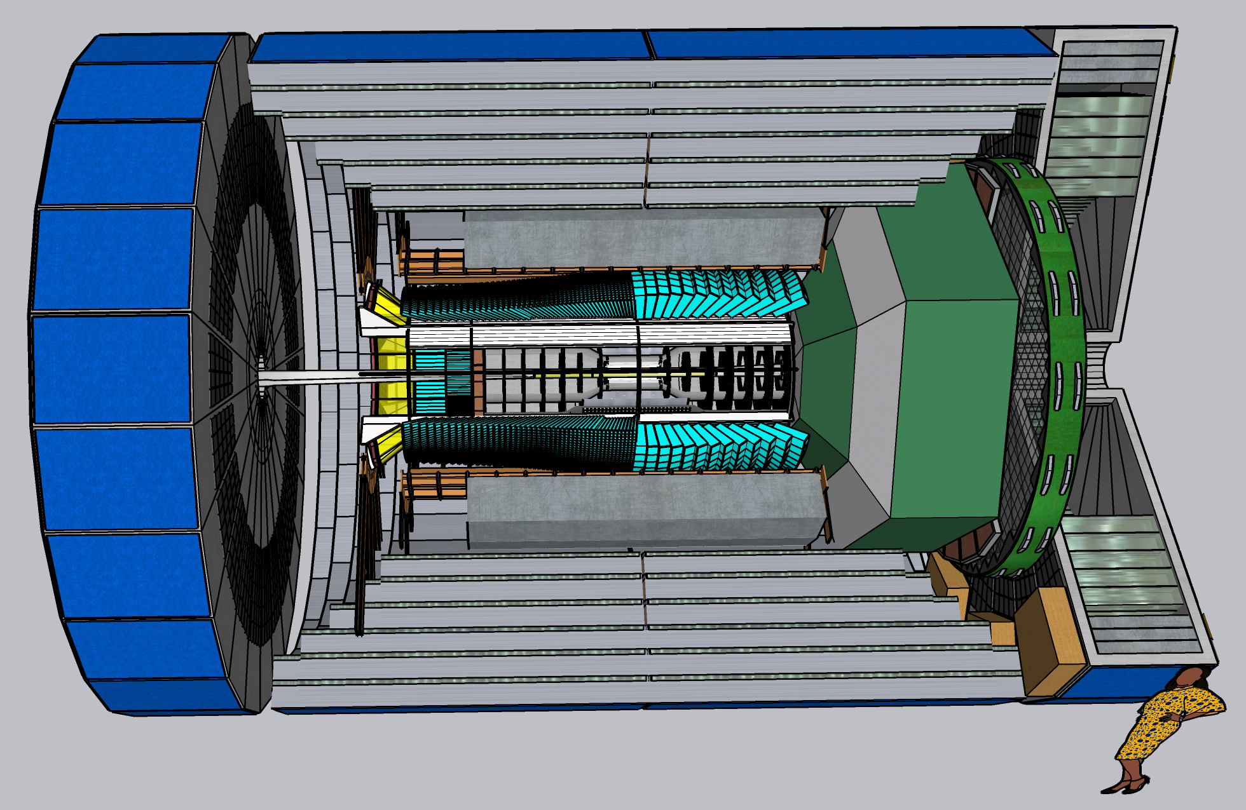
CORE General Meeting
7 June 2022

Slide 2
Agenda
Report on DIS 2022 (Santiago de Compostela)
Charles Hyde
Rare Isotope Program at EIC
Brynna Moran
Z-Tagging of far-forward projectile fragments at a secondary focus
Yordanka Ilieva
Future CORE meetings

Slide 3
DIS 2022
CORE presentations:
Gunar Schnell: CORE - a Compact Detector for the Electron-Ion Collider https://indico.cern.ch/event/1072533/contributions/4820527/
C. Hyde: Coherent Deep Virtual Compton Scattering on 4He with CORE@EIC https://indico.cern.ch/event/1072533/contributions/4782207/
IR8, Physics with Secondary Focus
Brynna Moran: Study of exotic nuclei made easy – a potentially novel topic for physics at the EIC https://indico.cern.ch/event/1072533/contributions/4779245/

Slide 4
DIS 2022 Working Group Summaries
WG6: Future Experiments Summary talk, Michela Chiosso: CORE listed as contender for 2nd Detector

